Slide 1

Kellogg
Company (K)
Consumer Staples Sector
Tom Winter and Andrew Kunisky
Spring 2009

Slide 2
Objective
Based on our economic outlook
  Looking to add a defensive stock
Kellogg fits in well with our investment strategy
  Minimizes our Sharpe Ratio, Portfolio Variance
Kellogg has numerous catalysts supporting our investment rationale

Slide 3
Kellogg Company
Founded 1906 in Battle Creek, Michigan
Global Producer of Cereal and Convenience Foods
2008 Revenue of nearly $12 billion
Employs over 30,000 people globally

Slide 4
Why Processed Food?
A Dependable Product
  Current economy is forcing people to rethink their eating habits
“Reversion to the Meal”
The food service industry has seen a significant drop
Food processors stand to gain from this

Slide 5
Threats
Peanut Butter Recall
The Peanut Butter Corp. of America has recalled all peanut paste because of a salmonella outbreak
Commodity Costs
While commodity prices have fallen significantly, most companies will not feel those effects until 2009
Pricing Wars
Private Label competition
Pressure from retailers
Foreign Exchange
Foreign Exchange in 2009 could adversely impact global profits

Slide 6

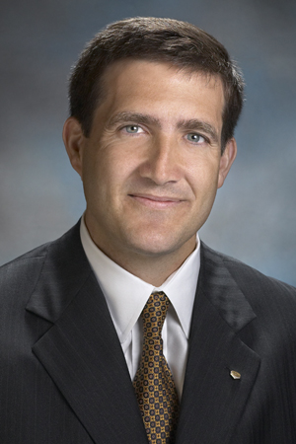
Officers
David Mackay- President and CEO
  Joined Kellogg in 1985
  Began as a category director (essentially a brand manager) for Kellogg Australia
  Industry experience: Sara Lee Bakery, former director of multiple industry organizations
  Global Experience: Management in Australia, Europe, and the United States
Source: Kellogg Corporate Website
John Bryant- COO,CFO
  Joined Kellogg 1998
  Experience in Kellogg’s global strategic planning
  process
  Management experience in Europe and Australia
  Background in Accounting (Deloitte & Touche Leadership)
Source: Kellogg Corporate Website

Slide 7
Management
Experience
Solid Vision
Internal Control
Execution

Slide 8
Product Success
  Sustainability
    Ability to adjust and adapt to consumer dynamics
  Dependability
    Global Market Leadership Team (GMLT)
  Performance
    “Think Globally, Act Locally”
    Ample Advertising
Product goals match business goals
  “Sustainable and Dependable Growth”
Source: Kellogg Company Filing
Notes:
-GMLT: Meets to share best practices and insights around our innovation pipeline, in-market performance, advertising campaigns and promotional programs.
Source: Kellogg Company Filing
-”Think Global…”: Building brand, consumer relationships by acting on local changes, while still instigating growth and expansion as they think globally.

Slide 9

Product Overview
Consists Mainly of
  Ready-To-Eat Cereals
  Convenience Foods
    Cookies
    Crackers
    Fruit Snacks
    Cereal Bars
    Frozen Waffles
    Toaster Pastries
Manufactured in 19 countries and marketed in over 180 markets
  80 plus brands sold in North America
  60 plus brands sold in International Markets
Source: Kellogg.com
Source: Kellogg.com

Slide 10
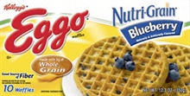
Product Overview
Major Brands Consists of:
  Kellogg’s
  Keebler
  Famous Amos
  Cheez-It
  Murray
  Austin
  Kashi
  Eggo
  All Bran
  Club
  Sandies
  Pop-Tarts
  Morningstar Farms
Source: Kellogg.com
Notes:
-Kashi: Emerging Growth Brand

Slide 11

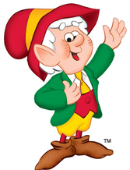
Source: Kellogg.com
Source: Kellogg.com

Slide 12
Innovation
Commitment to investing in innovation and R&D
  Improves an already strong portfolio by improving mix and producing higher returns
Take Global Approach
  Meet consumer needs around the world
  Global innovation teams focus on developing value-added and differentiated products
Source: Kellogg Company Filing

Slide 13
Innovation
In the process of a $40 Million expansion of the Kellogg’s Institute for Food Research
Innovation across the board: Cheez-It Flipsides, Special K Blueberry Muffin(huge showing in tests), etc
More than 270 new products were introduced in 2007 alone
Generated just about $2 billion, or 17% of sales, from products launched within the past three years
Source: Kellogg Company Filing

Slide 14
King Cereal
Highest Market Share of Cereal
Cereal is outperforming the industry as a whole
Brand recognition with cereal remains important
Kellogg faces very little private label penetration
Cereal will remain a business priority

Slide 15

-Lean
Source: Kellogg.com
Lean, Efficient, Agile, Network
K LEAN is a program that was instituted 6 years ago
  Annual savings of $1 Billion in 3 Years
This program focuses on in house efficiency improvements and overhead discipline
Has improved pricing abilities, cost controls, and this will continue past 2009

Slide 16
Advertising
Over $1 Billion in advertising in 2008 or 9% of sales
Unmatched in the industry
“Essential to achieving our goals.”- David Mackay CEO
Kellogg will spend consistent amounts of money on advertising in 2009
Media Deflation will lead to more impressions while spending remains constant
  This allows for a greater media mix and optimization
“More bang for their advertising buck”
Media Deflation

Slide 17
Industry Comparison
Advertising as a % of Sales
 | 2007 | 2006 | 2005
K | 9% | 8.40% | 8.40%
GIS | 4.4% | 4.5% | 4.3%
HSY | 2.6% | 2.2% | 2.6%
KFT | 4.2% | 4.1% | 3.9%
DLM | 3.1% | 2.6% | 2.9%

Slide 18
Key Statistics
 | K | GIS | KFT | RAH
MCAP | 15.41B | 18.19B | 35.51B | 3.54B
PE | 13.46 | 15.47 | 12.66 | 12.72
F PE | 11.97 | 13.05 | 11.86 | 13.62
P/CF | 10.07 | 11.59 | 12.81 | 12.06
PEG | 1.49 | 1.65 | 2.04 | 1.76
B | 0.46 | 0.27 | 0.56 | 0.29
DIVY | 3.39 | 3.05 | 4.69 | NONE
QUICK | 0.46 | 0.49 | 0.69 | 0.6
CURRENT | 0.71 | 0.81 | 1.03 | 1.33
D/E | 2.12 | 1.5 | 0.78 | 1.16
GM | 41.86 | 33.35 | 33.21 | 20.34
OM | 15.23 | 14.72 | 9.04 | 8.96
PM | 8.95 | 7.98 | 4.38 | 5.67
ROE | 57.78 | 23.18 | 7.47 | 12.84
ROI | 15.57 | 8.66 | 3.39 | 5.61
ROA | 10.28 | 6.01 | 2.82 | 5.04

Slide 19
Inventory
Inventory Turnover Per Quarter
 | Q4 2008 | Q3 2008 | Q2 2008
K | 1.98 | 2.07 | 2.01
GIS | 1.76 | 1.44 | 1.78
KFT | 1.98 | 1.52 | 1.42
RAH | 2.14 | 2.07 | 2.22

Slide 20
Private Label Penetration
Consumer trade down growing in the US in the back half of 2008
Consumers are going to private label with less money to spend on discretionary groceries
Kellogg’s main staples are set up well enough to avoid major market share loss to private labels
Almost 10% less penetration than the industry average
Kellogg’s enjoys a loyal consumer base as well as increasing brand recognition

Slide 21
Kellogg and Industry Threats
Commodity Prices
  High commodity prices threaten margin
  Corn, Wheat, Rice are Kellogg’s biggest commodities
  The company has hedged 70% of all commodities through the first half of 2009
Estimated breakdown of commodity exposure by company:
K GIS KFT
Raw materials as % sales 30.1% 39.1% 35.0%

Slide 22
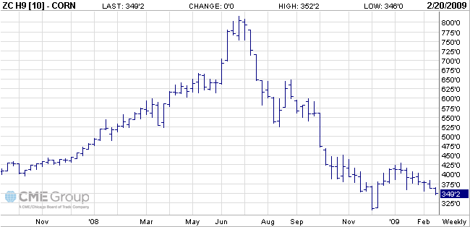
CORN

Slide 23
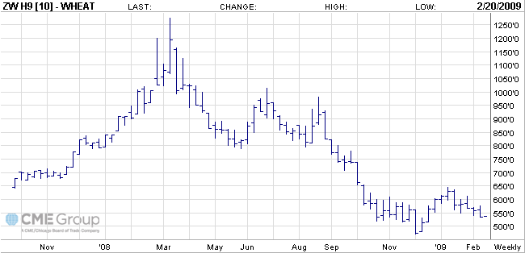
Wheat

Slide 24
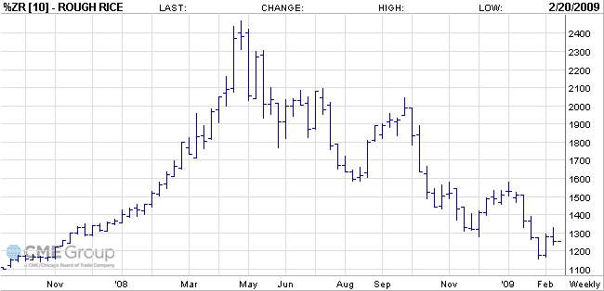
Rice

Slide 25
Commodity Futures
Corn
Months | Future Prices
March 09 | 349'2
May 09 | 359'0
July 09 | 368'6
September 09 | 378'4
December 09 | 390'2
Wheat
Months | Future Prices
March 09 | 515'4
May 09 | 528'0
July 09 | 540'2
September 09 | 564'0
December 09 | 585'2
Rice
Months | Future Prices
March 09 | 12.080
May 09 | 12.230
July 09 | 12.390
September 09 | 12.350
January 10 | 12.625
Soybeans
Months | Future Prices
March 09 | 903'0
May 09 | 904'4
July 09 | 908'0
September 09 | 870'0
January 10 | 862'0

Slide 26
The Peanut Recall
      2008
Cost 34 million dollars in 2008.
6 cents expense in EPS from the peanut butter.
Costs broken down into:
  ½ in inventory
  1/3 in sales reversal
  1/6 in retrieval
Priced-In Stock
      2009
Company projects another 6 cents expense in their EPS
Broken Down into:
  1/3 in retrieval/cost of sales
  2/3 in business disruption
Additional concern going forward for more recalls. Contributed mainly by:
  The increased complexity of the global food network
  Increased media coverage
  Heightened consumer awareness
  An influx of food contamination-related regulations
  Civil Lawsuits

Slide 27
Kellogg and Industry Threats
Foreign Exchange Risk
  Currency Fluctuations can have and adverse impact on profits
  FX issues make a difference with a global company like Kellogg
  Kellogg hedges against North American currencies only

Slide 28
M&A
Late in 2007 acquired Bear Naked Inc.
  Maker of all-natural granola and trail mixes
  Gardenburger brand
Early in 2008 acquired The United Bakers Group (UB)
Many small global acquisitions in 2H08
  “Platforms for learning about emerging markets”
Source: Kellogg Company Filing

Slide 29
Financials
Source: Kellogg Company Filing

Slide 30

Financials
Source: Kellogg Company Filing

Slide 31
Financials
Source: Kellogg Company Filing

Slide 32
Financials
Source: Kellogg Company Filing

Slide 33
Financials
Source: Kellogg Company Filing
Notes:
-Cash flow is defined as net cash provided by operating activities, reduced by capital expenditures. The Company uses this
non-GAAP financial measure to focus management and investors on the amount of cash available for debt repayment,
dividend distributions, acquisition opportunities and share repurchases. Refer to Management’s Discussion and Analysis
within Form 10-K for reconciliation to the comparable GAAP measure.
Source: Kellogg Company Filing

Slide 34
Income Statement
(In Millions) | 2008 | 2007 | 2006 | 2005
Revenue | 12,822 | 11,776 | 10,906 | 10,177
Cost of Goods Sold | 7,455 | 6,597 | 6,081 | 5,611
Gross Margin | 5,367 | 5,179 | 4,825 | 4,565
Selling and Admin. Exp. | 3,414 | 3,311 | 3,059 | 2,815
Depreciation | 375 | 372 | 353 | 392
EBIT | 1,633 | 1,866 | 1,779 | 1,725
Net Income | 1,148 | 1,103 | 1,004 | 980

Slide 35
Balance Sheet
(In Millions) | 2008 | 2007 | 2006 | 2005
Cash | 255 | 524 | 410 | 219
Net Receivables | 1,143 | 1,026 | 1,060 | 879
Inventory | 897 | 924 | 823 | 717
Current Assets | 2,521 | 2,717 | 2,427 | 2,196
PP&E | 2,933 | 2,990 | 2,815 | 2,648
Total Assets | 10,946 | 11,397 | 10,714 | 10,574
Accts. Payable | 1,135 | 2,570 | 2,979 | 1,994
Current Liabilities | 3,552 | 4,044 | 4,020 | 3,162
Long Term Debt | 4,068 | 3,270 | 3,053 | 3,702
Total Liabilities | 9,498 | 8,871 | 8,645 | 8,290
Retained Earnings | 4,836 | 4,217 | 3,630 | 3,266
Total SHE | 1,448 | 2,526 | 2,069 | 2,283
Total SHE & TL | 10,946 | 11,397 | 10,714 | 10,574
*300 Million year-end retirement contribution

Slide 36
Cash Flow
 | 2008 | 2007 | 2006 | 2005
Net Income | 1,148 | 1,103 | 1,004 | 980
Depreciation | 375 | 372 | 353 | 392
Net Cash from OA | 1,267* | 1,503 | 1,410 | 1,143
Cap. Expenditures | - | (472) | (453) | (374)
Net Cash Used IA | (681) | (601) | (445) | (415)
Dividends |  | (475) | (449) | (435)
Common Stock Buyback | (650) | (487) | (432) | (442)
Net Cash from FA | (780) | (788) | (789) | (905)
F/X Effect | (75) | (1,000) | 15,400 | (21,300)
Change in Cash | (269)* | $113,000 | $191,500 | ($198,300)
*300 Million year-end retirement contribution

Slide 37
Cash Is King
Operating Principle Direction
  Reduce Core Working Capital
  Prioritize Capital Expenditure
  Increase ROI
  Improve Financial Flexibility
  Grow Net Earnings
Kellogg’s biggest cash use is returning cash to shareholders!

Slide 38
Portfolio Management
How Does This Fit In With Our Portfolio?
($3,000 to $4,000 Investment)
Complementary to the Madison Investment Fund portfolio
Food can enhance the fund’s diversification

Slide 39
Investment Rationale
Value
  52-Week Low
  Low historical P/E
Portfolio Strategy
Advertising/ Brand / Product Innovation
  Media Deflation
Low Private Label Competition
Cereal Inelasticity
  Determined “to win U.S. Cereal”
Recent $650 mil. stock repurchase announcement
Productivity and Cost Saving
Superior management effectiveness and profitability ratios

Slide 40
One Year Chart

Slide 41
Kellogg Vs. S&P 500 Vs. ETF PBJ

Slide 42
Kellogg Vs. Competitors

Slide 43
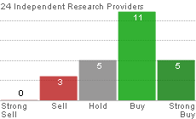


Analyst Coverage
17 Wall Street Analysts in consensus
Average consensus recommendation is 1.8824
(On a 1-5 scale, 1 being a strong buy, 5 a strong sell)
Jaywalk
Consensus
Report

Slide 44

Questions?

